Slide 1

Build & Test Prep Design Review
Team 18104

Slide 2
Background
My role is the Lead Thermal and Structural Engineer
Our team is in a unique situation because
Over the summer, I designed and built a chassis to mount the electronics to
I am now working on a thermal model for Dr. Patru as my primary assignment which involves little or no designing and building
Trying to follow the MSD schedule does not make sense for this assignment
No physical testing is planned because of a lack of access to an appropriate vacuum-capable thermal test chamber
Our team is behind schedule because we were working towards a fall launch with the old team’s system, that did not end up happening
A lot of time was wasted unfortunately working with the old system and trying to get it ready for launch
however, a lot was learned in the process
We are still trying to catch up

Slide 3
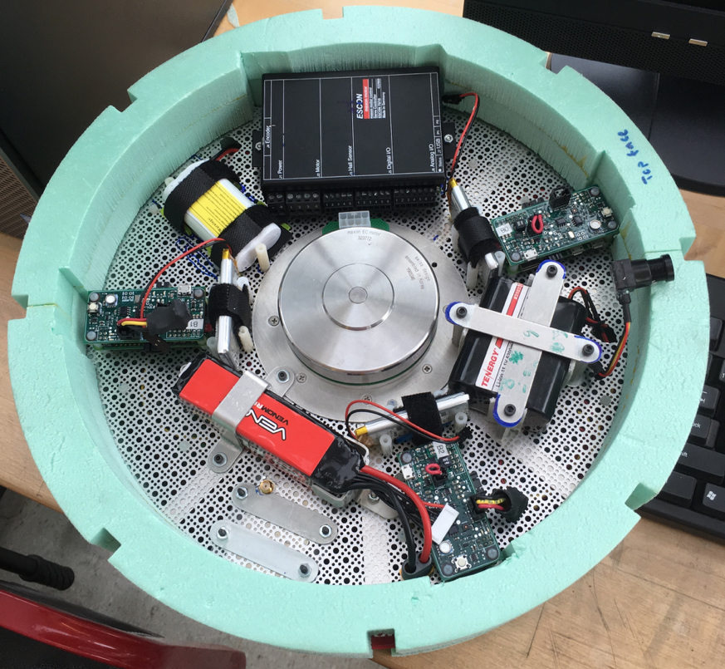
The Chassis (for fall launch)
Similar design has been built and will be populated for spring launch
Improved ease of access to electronics
Reduced rotational moment of inertia
Less power will be required of the motor to stabilize the platform
Reduced weight
Actual chassis is 77% lighter than last year’s team
Meet FAA requirements
Impact force per unit area not required in this weight class
Foam adds buoyancy and impact protection

Slide 4
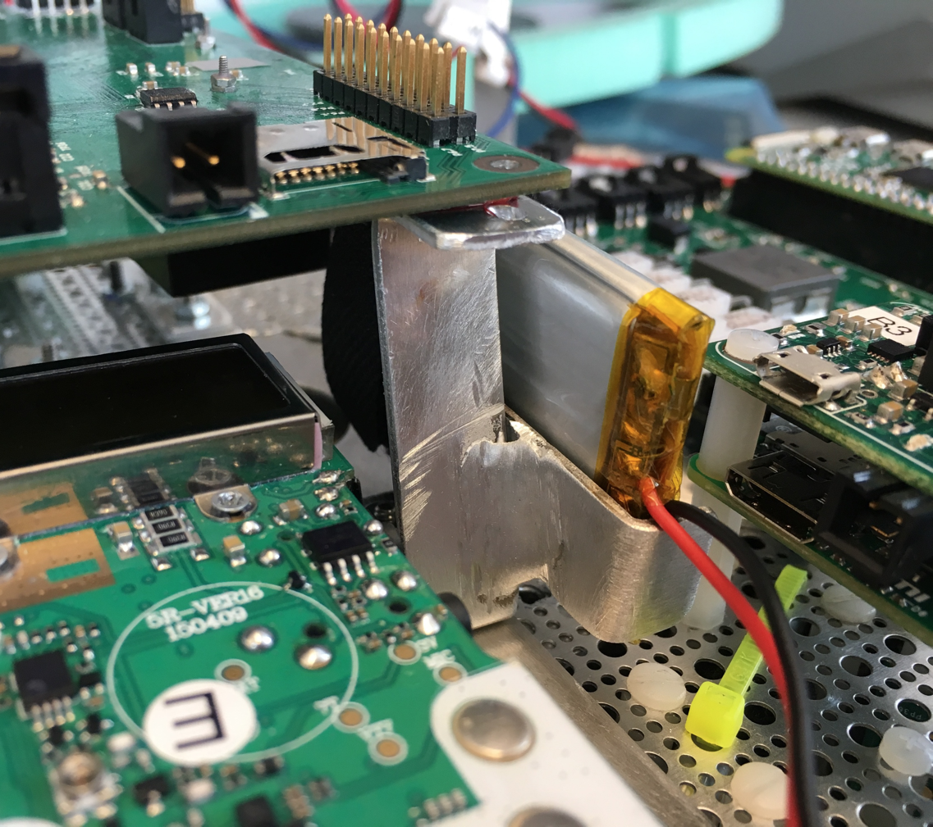
The Chassis (continued)
Electronics are hard-mounted to the metal mesh
More secure than foam mount
Heat can be easily transferred between hot and cold electronics, to prevent temperature extremes
Electronics are organized in a way that is balanced and reduces wire length
A nearly identical layout will be used for the final launch

Slide 5
The Chassis (continued)
No testing is planned for the chassis
No customer requirements are directly related to the chassis
Customer (Dr. Patru) fully approved the design of the chassis already
No need for change

Slide 6
Thermal protection
About
Platform uses layered 1.25” thick home insulation foam to protect electronics.
Glued to the outside is a radiation shield, similar to a thermal blanket
Protects electronics from interference caused by direct solar radiation
Protects the platform from building up heat from solar radiation.
Is there cause for concern?
Last year the was no temp problem
Low temperatures
US standard temperature for 100,000 ft is -46°C
Coldest point is -56°C
Our requirement is to stay above -40°C
High temperatures
Appears that last year’s platform stayed below 60°C internally and produced more heat than we expect to
Temperature distribution should be more even this year because of metal chassis

Slide 7
Thermal Modeling
About
Platform uses layered 1.25” thick home insulation foam to protect electronics.
Glued to the outside is a radiation shield, similar to a thermal blanket
Protects electronics from interference caused by direct solar radiation
Protects the platform from building up heat from solar radiation.
Is there cause for concern?
Last year the was no temp problem
Low temperatures
US standard temperature for 100,000 ft is -46°C
Coldest point is -56°C
Our requirement is to stay above -40°C
High temperatures
Appears that last year’s platform stayed below 60°C internally and produced more heat than we expect to
Temperature distribution should be more even this year because of metal chassis

Slide 8
What if the Thermal Modeling shows the HAB will get too hot or too cold?
Too cold:
We can add hand warmers or a resistive heater
Too hot:
We can extend the metal mesh beyond the foam to reject heat as radiation
We can paint the with white high IR emittance paint to increase heat rejection and decrease radiation absorption
Krylon makes a readily available paint that has such properties

Slide 9
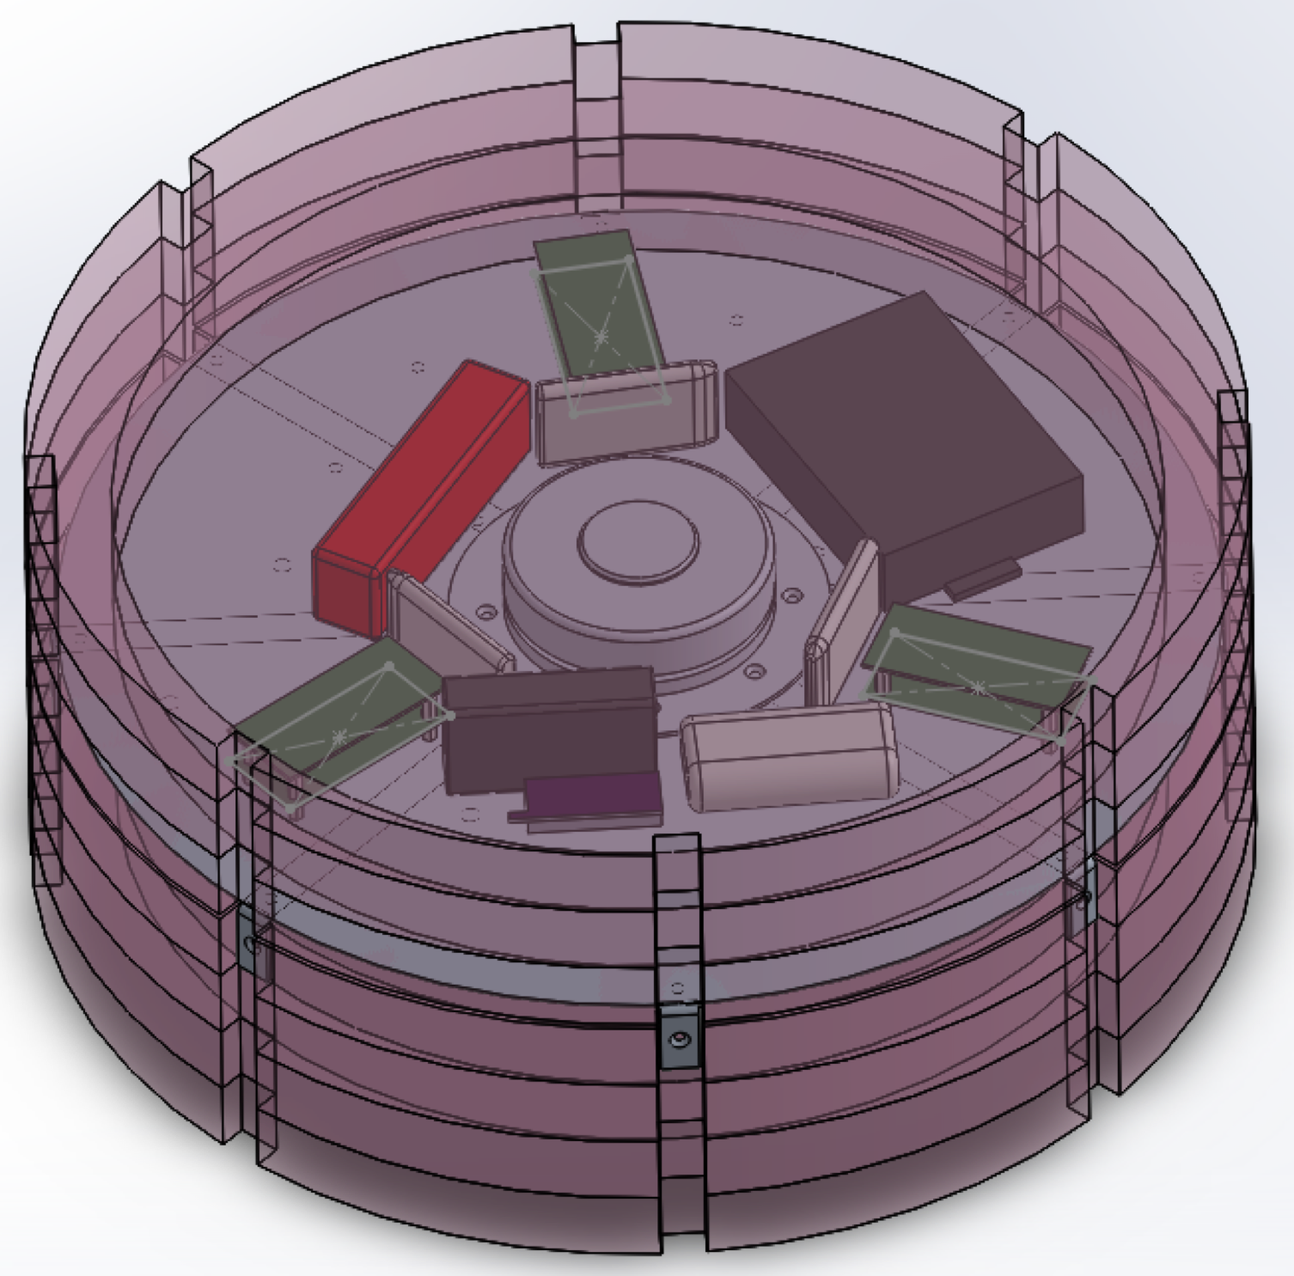
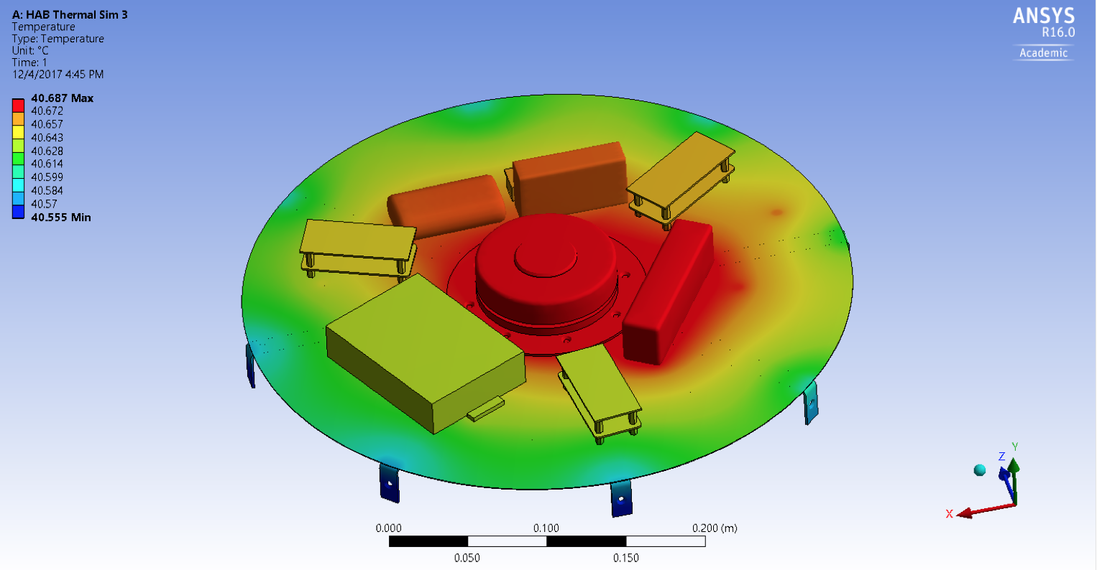
Thermal Modeling Strategy
HAB was CAD modeled in Solidworks
Model was imported into ANSYS and the heat distribution throughout the chassis and electronics was simulated
Hand calculations were performed to check results
Matlab/Simulink/Simscape are being used to determine the high-level heat transfer in and out of the platform

Slide 10
ANSYS Simulation
Parameters
Estimated heat generation in each of the boards, motor and battery
STP initial conditions
Conduction through the frame, mounts and electronics
Steady State simulation
Radiation from the ends of the frame, perfect insulation everywhere else
Model showed that temperature was very even throughout the platform.
Hand calculations were performed to verify the over all results, and they did not match, so the model cannot be trusted.
I have been trying to figure out why, but to no avail.
Instead I have now focused my efforts on the Simscape high-level model, because that will give an idea of the overall temperature within the HAB
I will investigate further when I have time

Slide 11
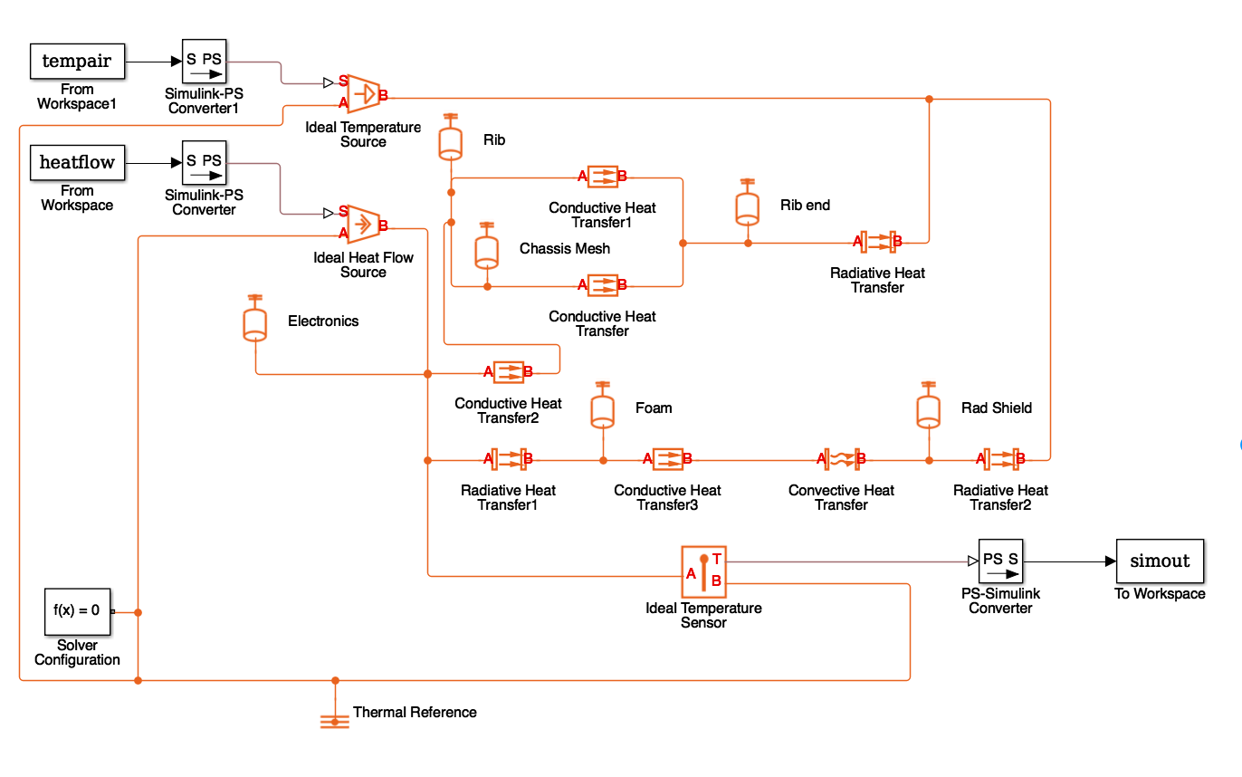
Simscape Simulation
A detailed thermal circuit of the entire HAB was drawn up
A basic Simscape thermal circuit was created and works as expected.
That simulation needs to have the rest of the HAB thermal circuit programmed into it
The simulation will be complex and iterative because of the enormous amount of unknowns and and the nature of radiative heat transfer

Slide 12
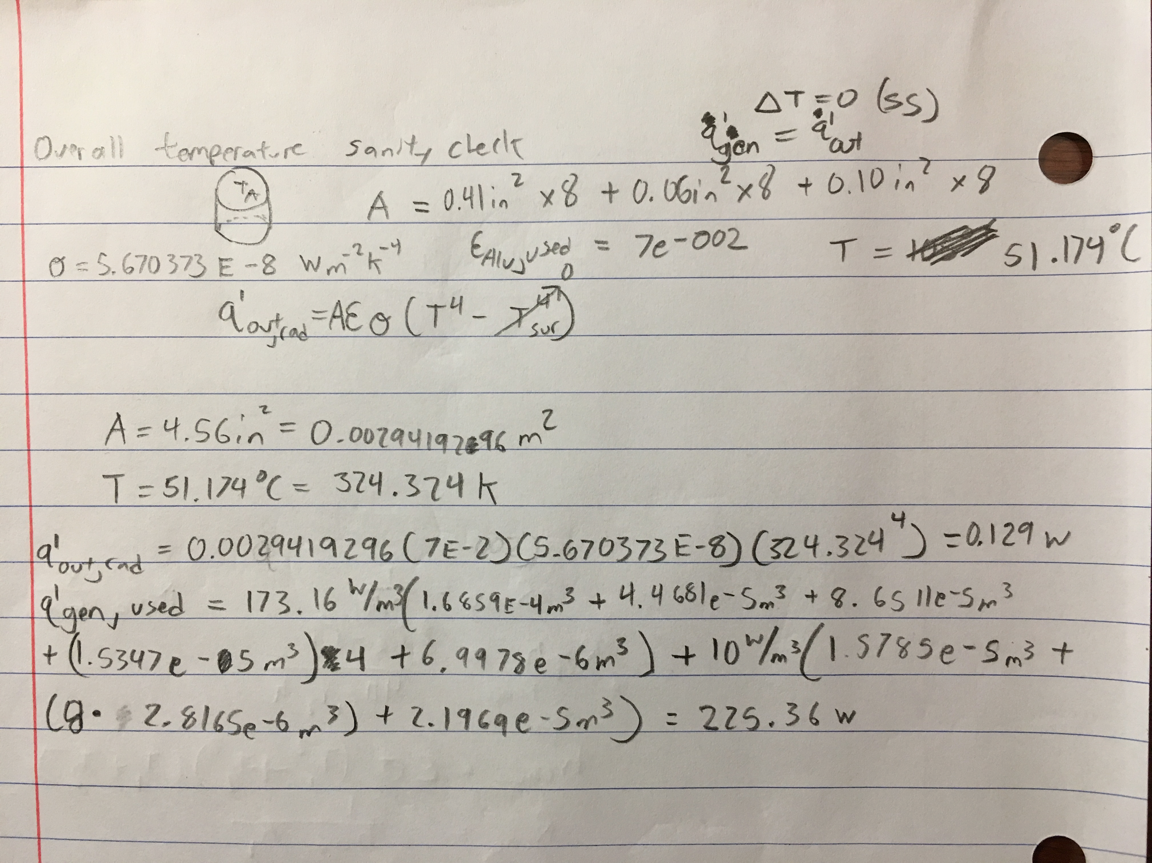

Slide 13
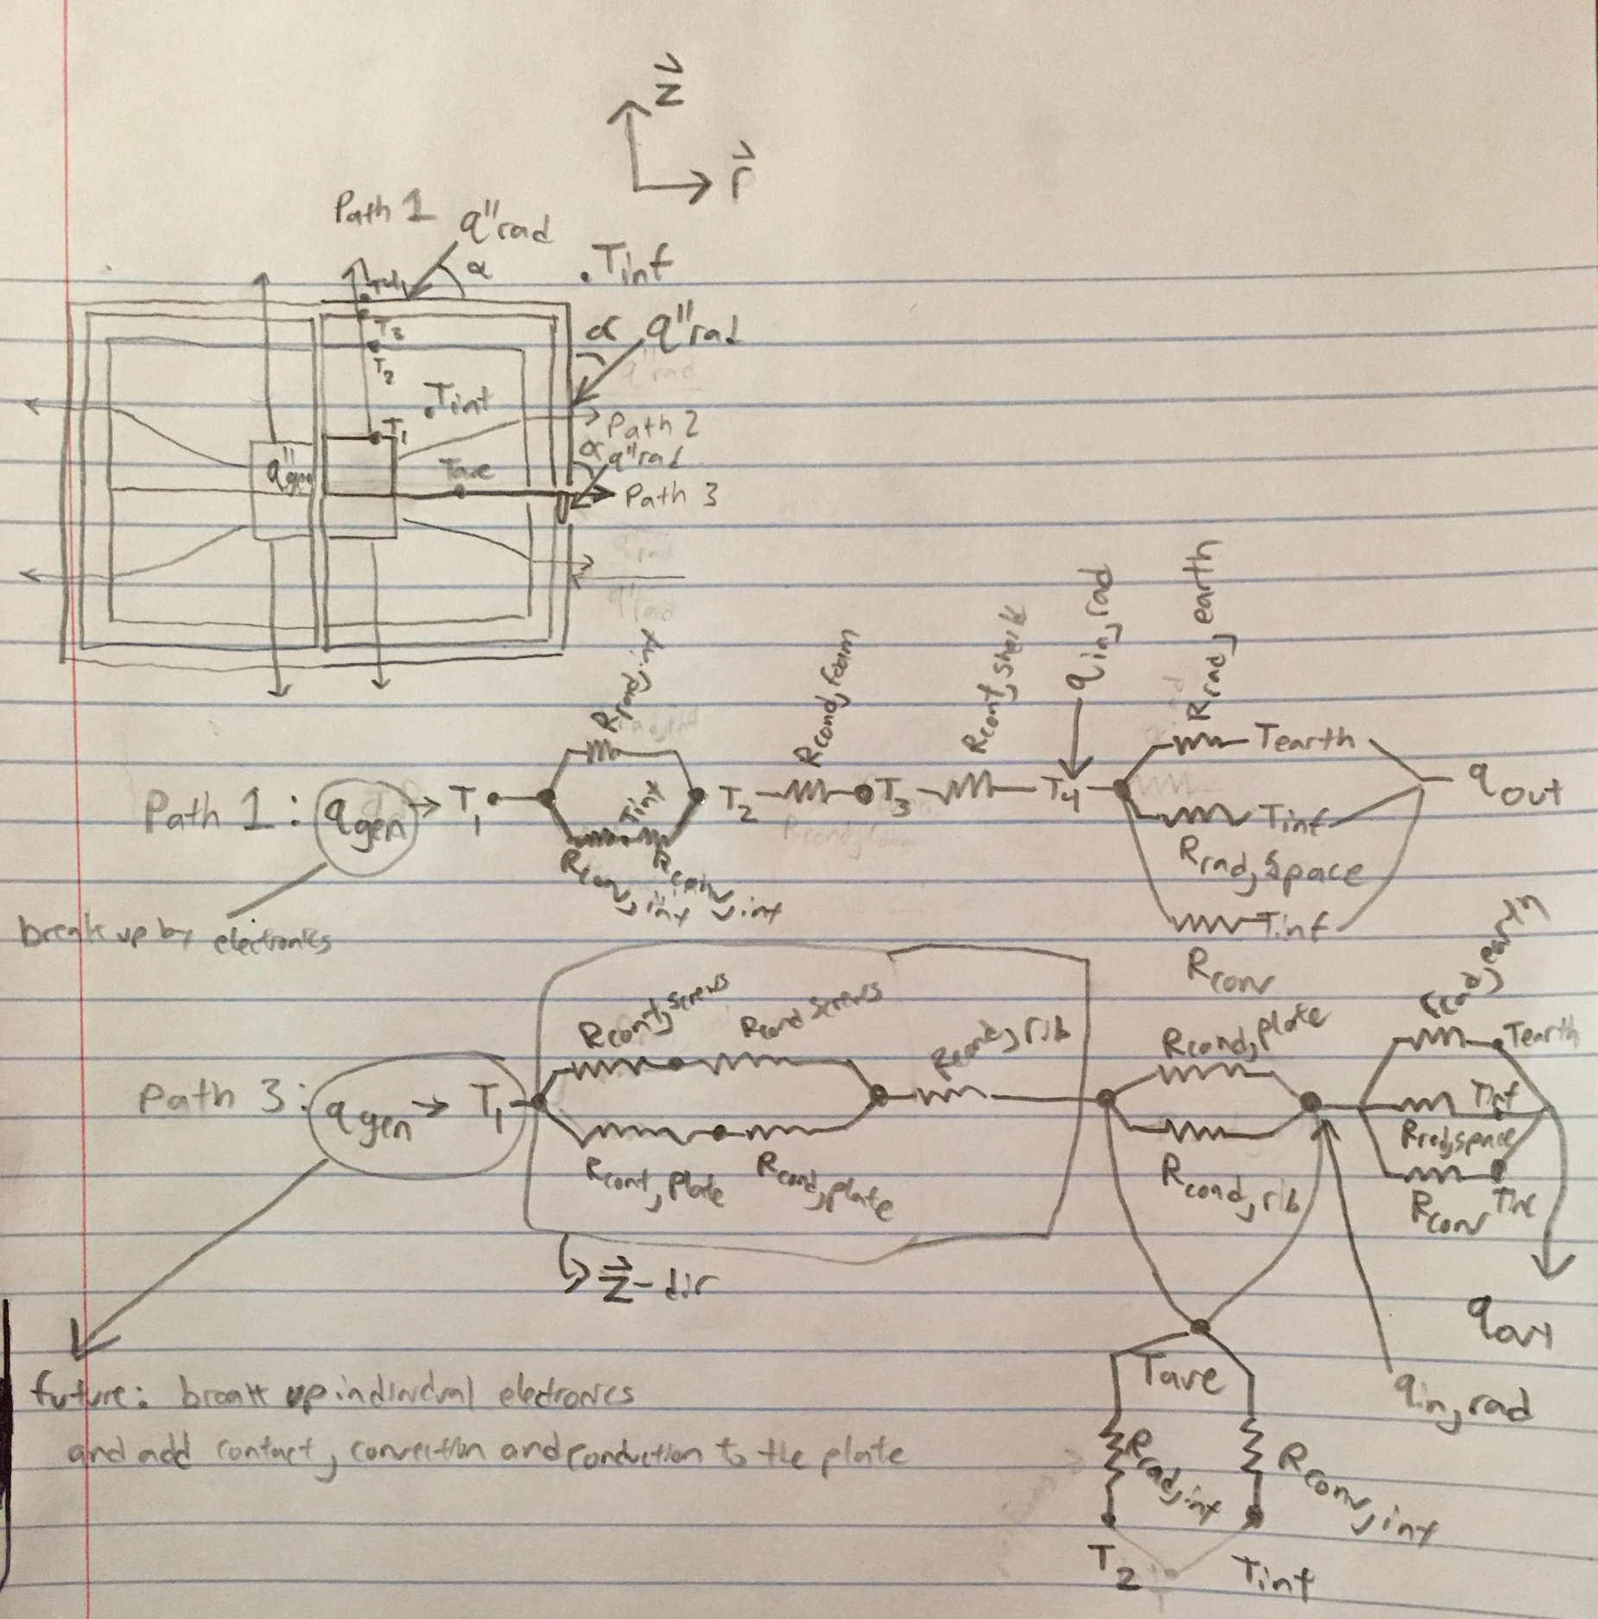

Slide 14
Future Simulations to Run
I will attempt to run as many of these simulations as I can run before my attention needs to be diverted to building and preparing the HAB for launch.
Run SS worst case hot (max radiation, insulation and heat generation)
Run SS worst case cold (min radiation, insulation and heat generation)
Run SS best guess
Compare sensor data to SS best guess and make necessary adjustments to sim
Calculate convection coefficients for:
Natural convection inside the HAB
Forced convection outside the HAB
Run SS best guess at 10,000 ft increments including convection
Create and run transient sim
(best guess, worst case high and low)
Run transient sim with previous teams conditions and compare results

Slide 15
Personal Timeline
SS worst case hot
SS worst case cold
SS best guess
Have foam cut
Mount electronics in foam
Compare sensor data
Convection coeff. Inside
Convection coeff. Outside
Transient best guess
Transient worst case high
Transient worst case low
Transient sim w/previous
By Feb 10
By Feb 10
By Feb 10
By Feb 10
By Feb 14
By Feb 17
By Feb 17
By Feb 17
By Feb 24
By Feb 24
By Feb 24
By Feb 24
Bold = Hardware & construction

Slide 16
Timeline (cont.)
Have all electronics mounts completed
SS best guess increments including convection
ANSYS sim review and get working
SS best guess with Internal Radiation
Transient best guess with internal Radiation
All remaining finishing items
Launch
By Mar 17
By Mar 24
By ???
By Mar 24
By Mar 24
By Mar 31
April 1 -15
Bold = Hardware & construction

Slide 17
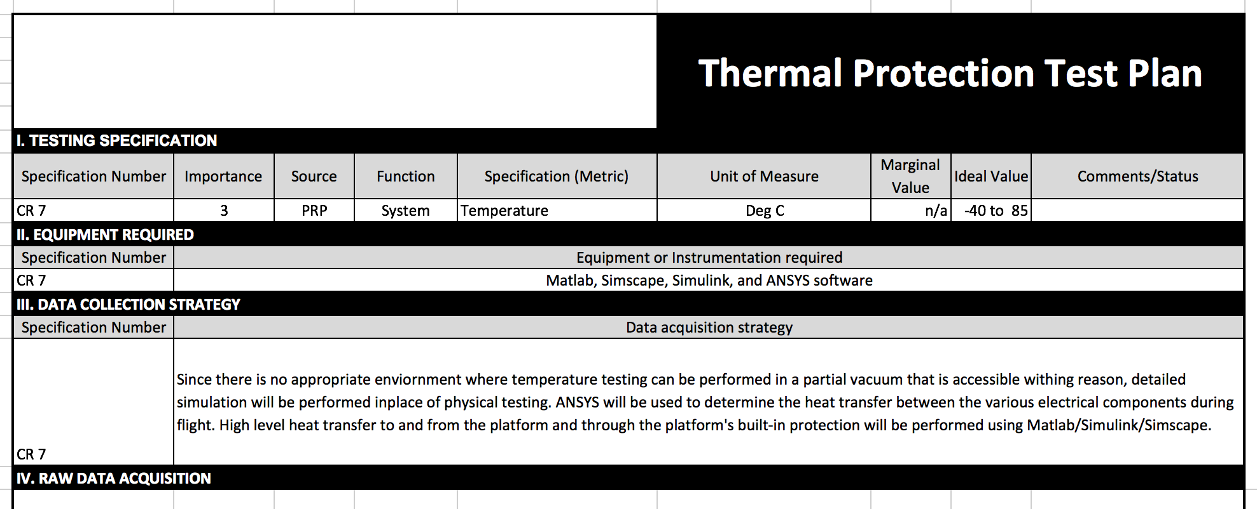
Thermal protection

